Slide 1
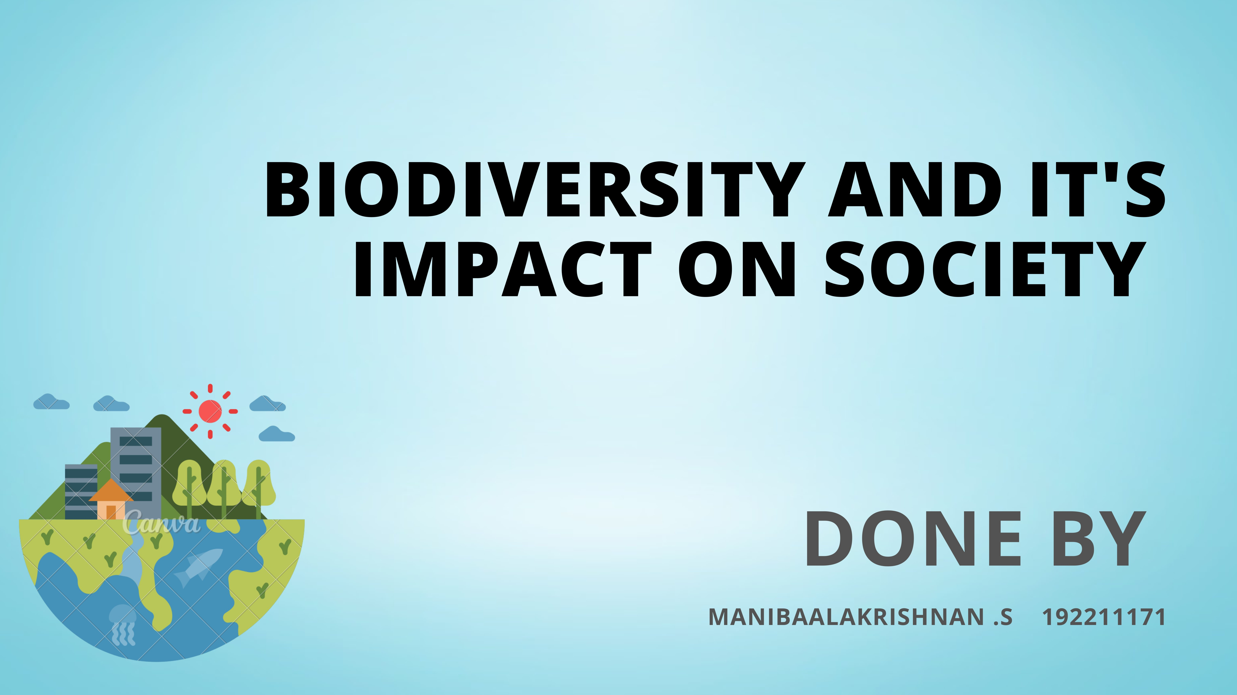

Slide 2
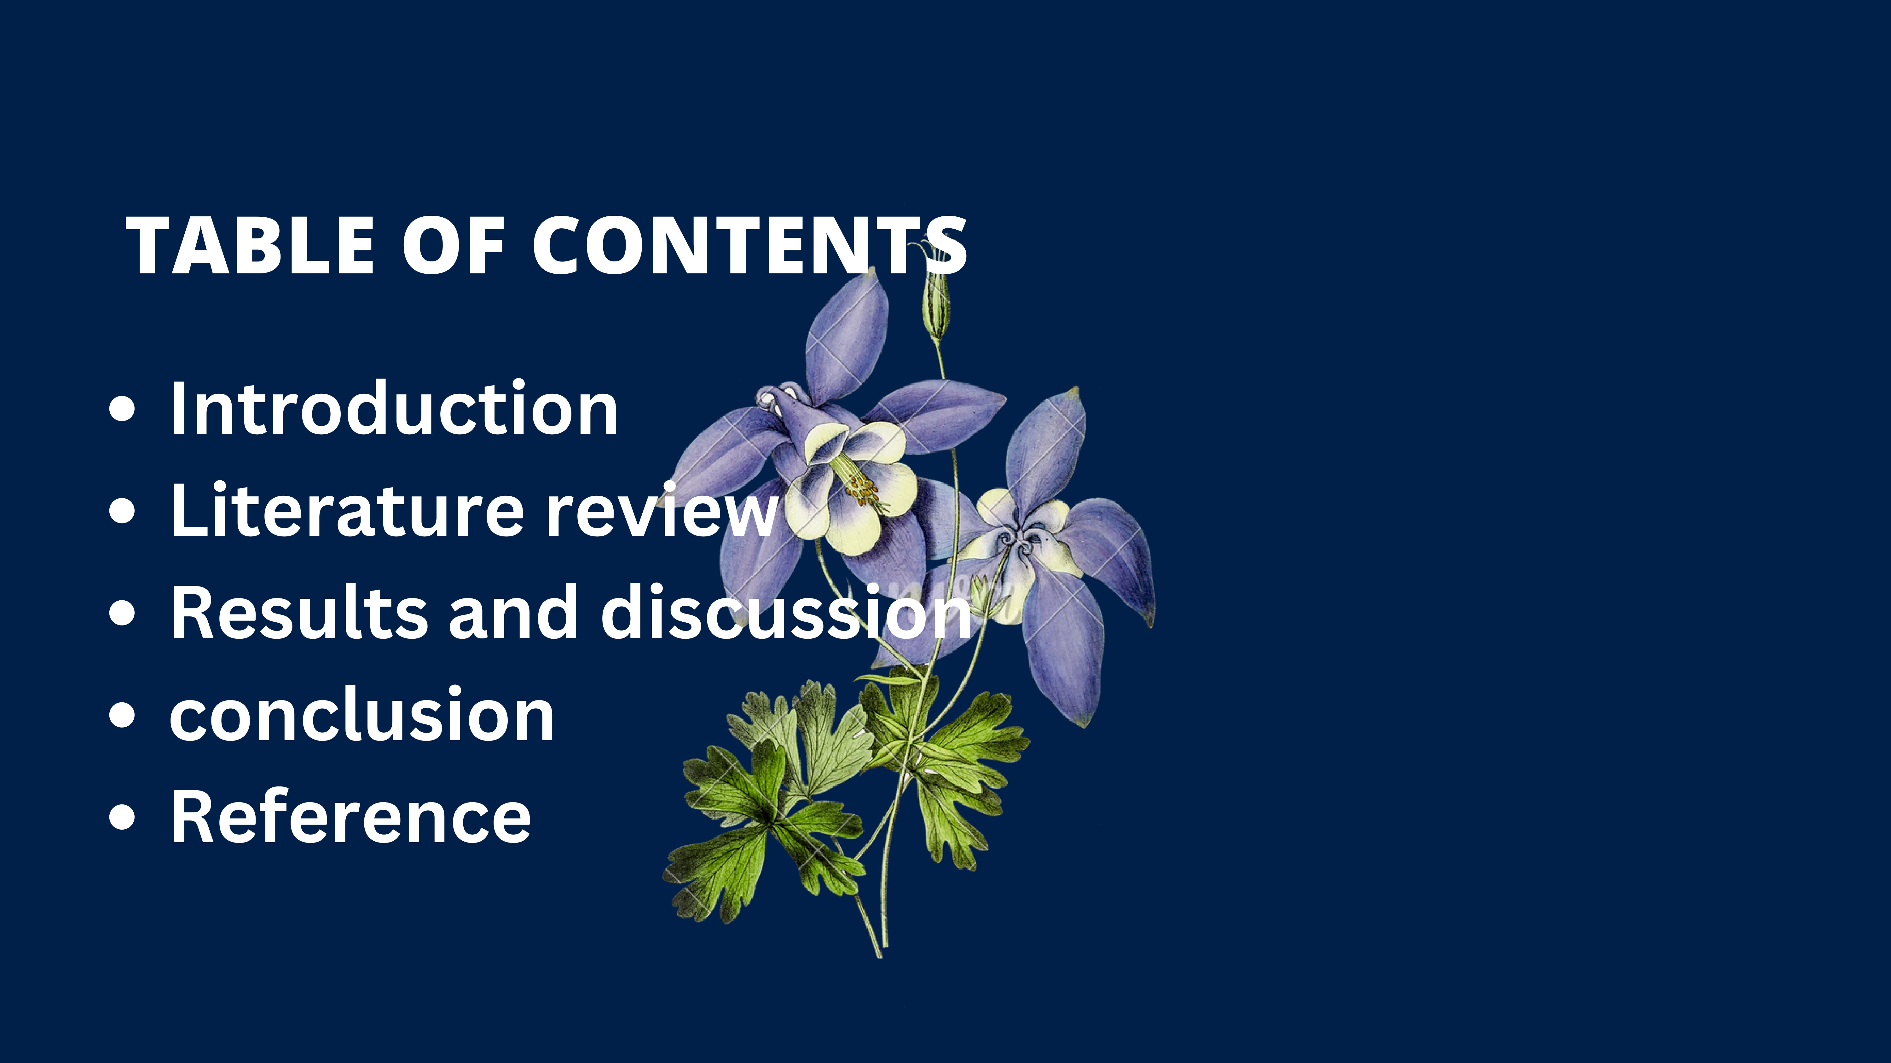

Slide 3
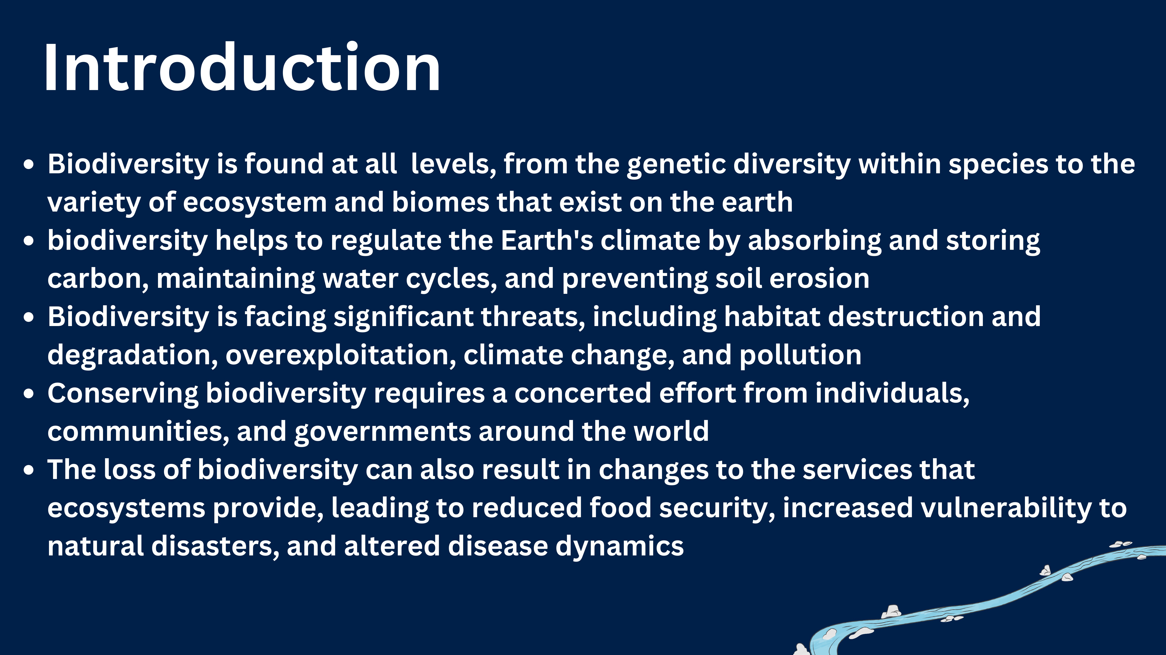

Slide 4
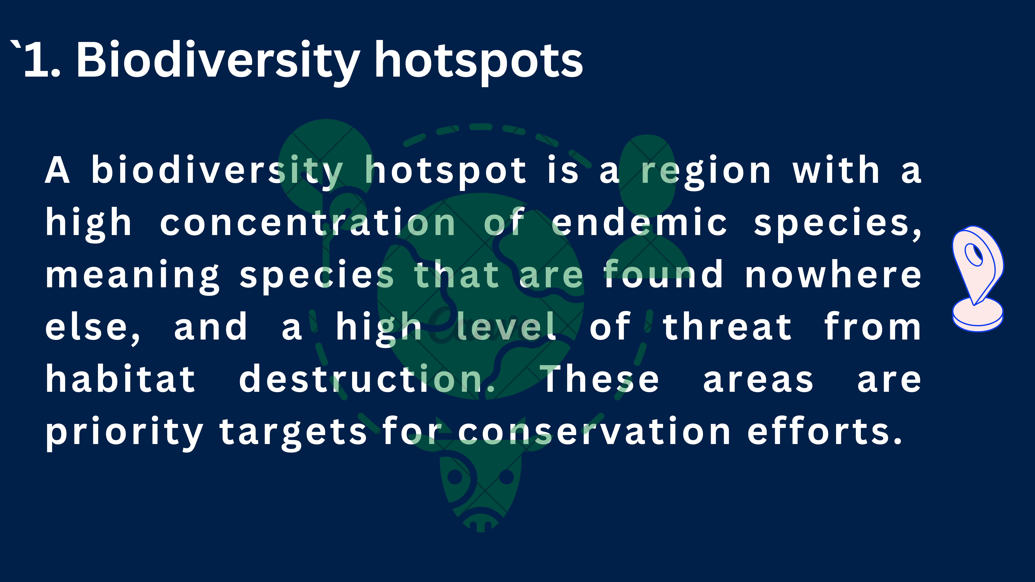

Slide 5
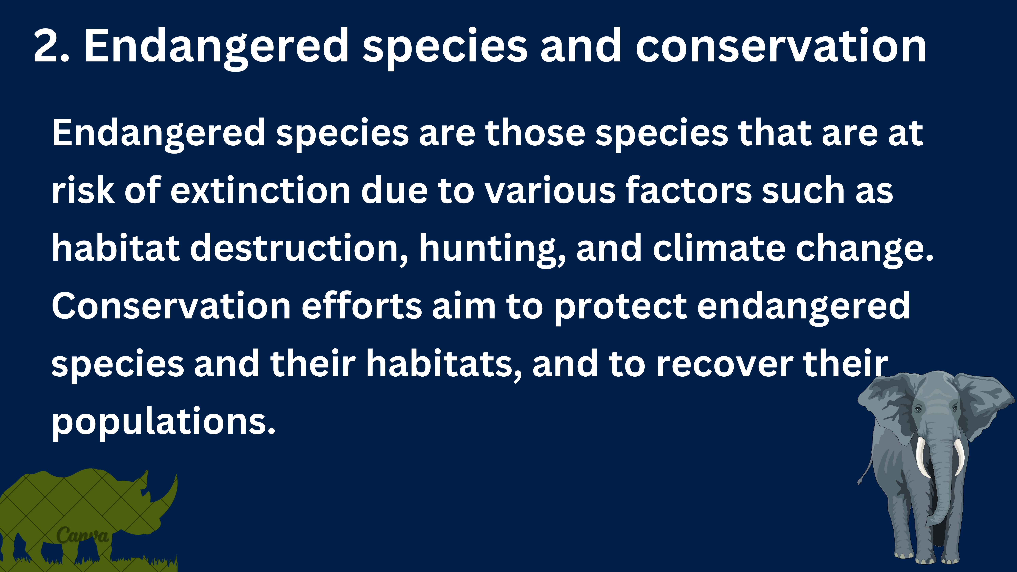

Slide 6
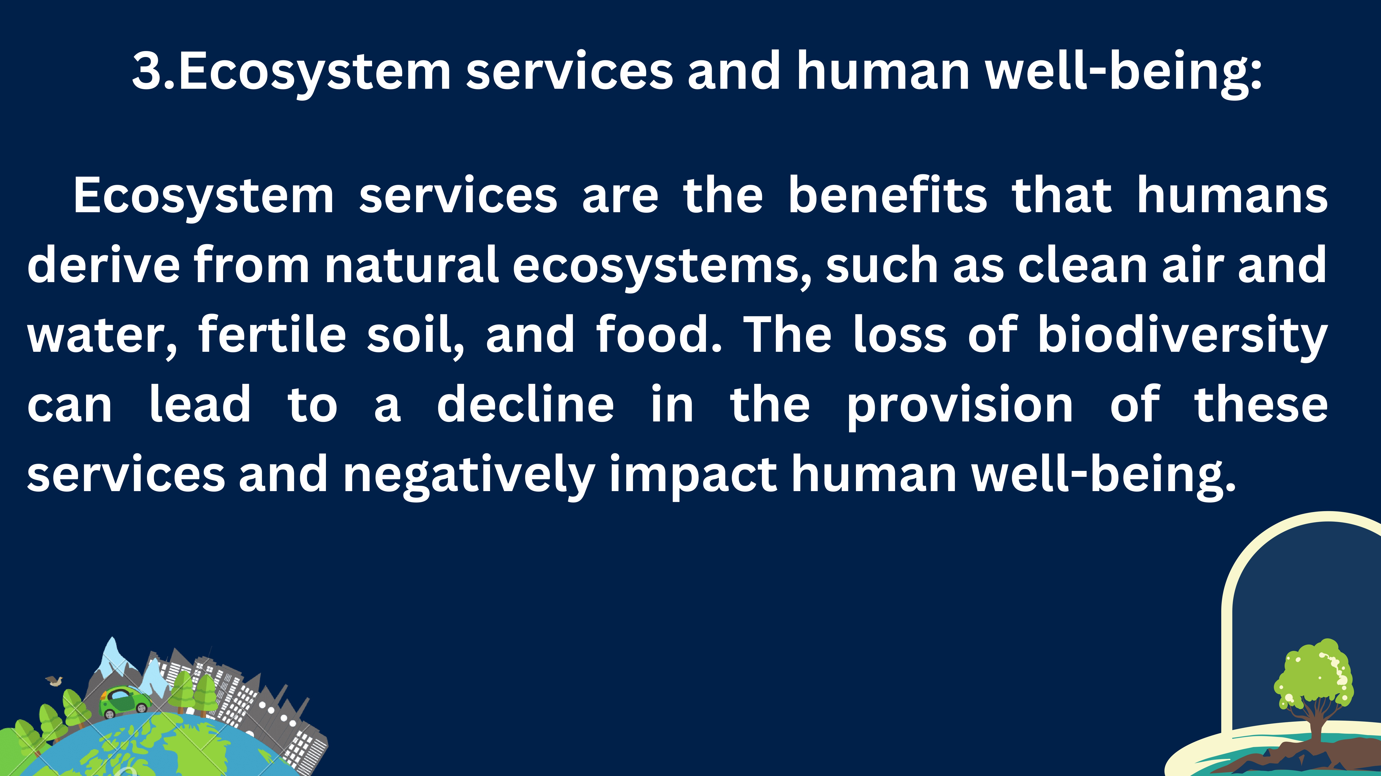

Slide 7
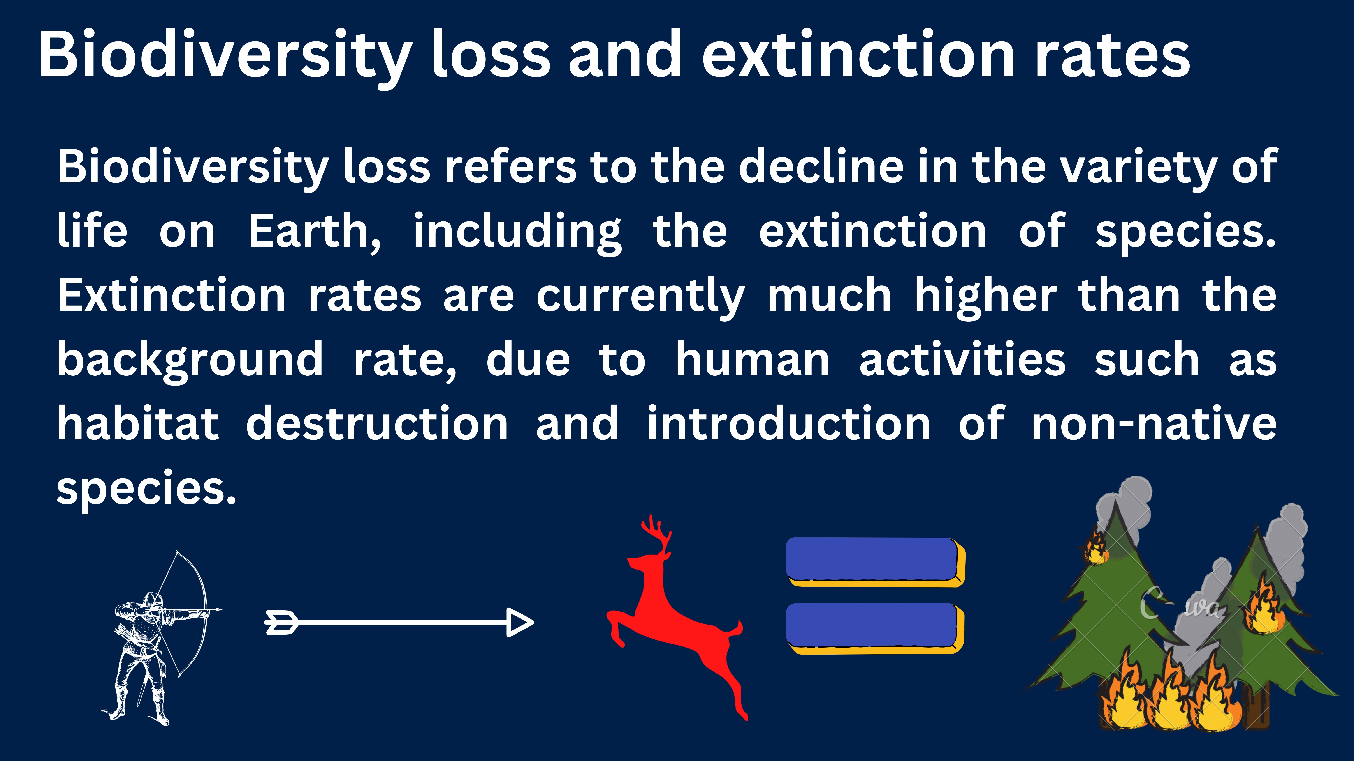

Slide 8
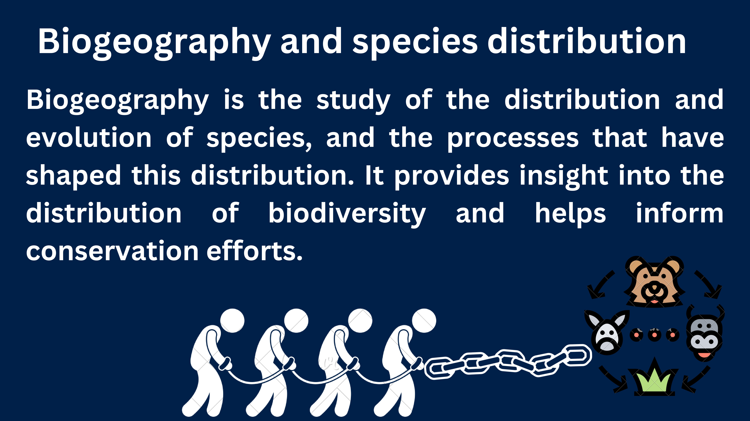

Slide 9
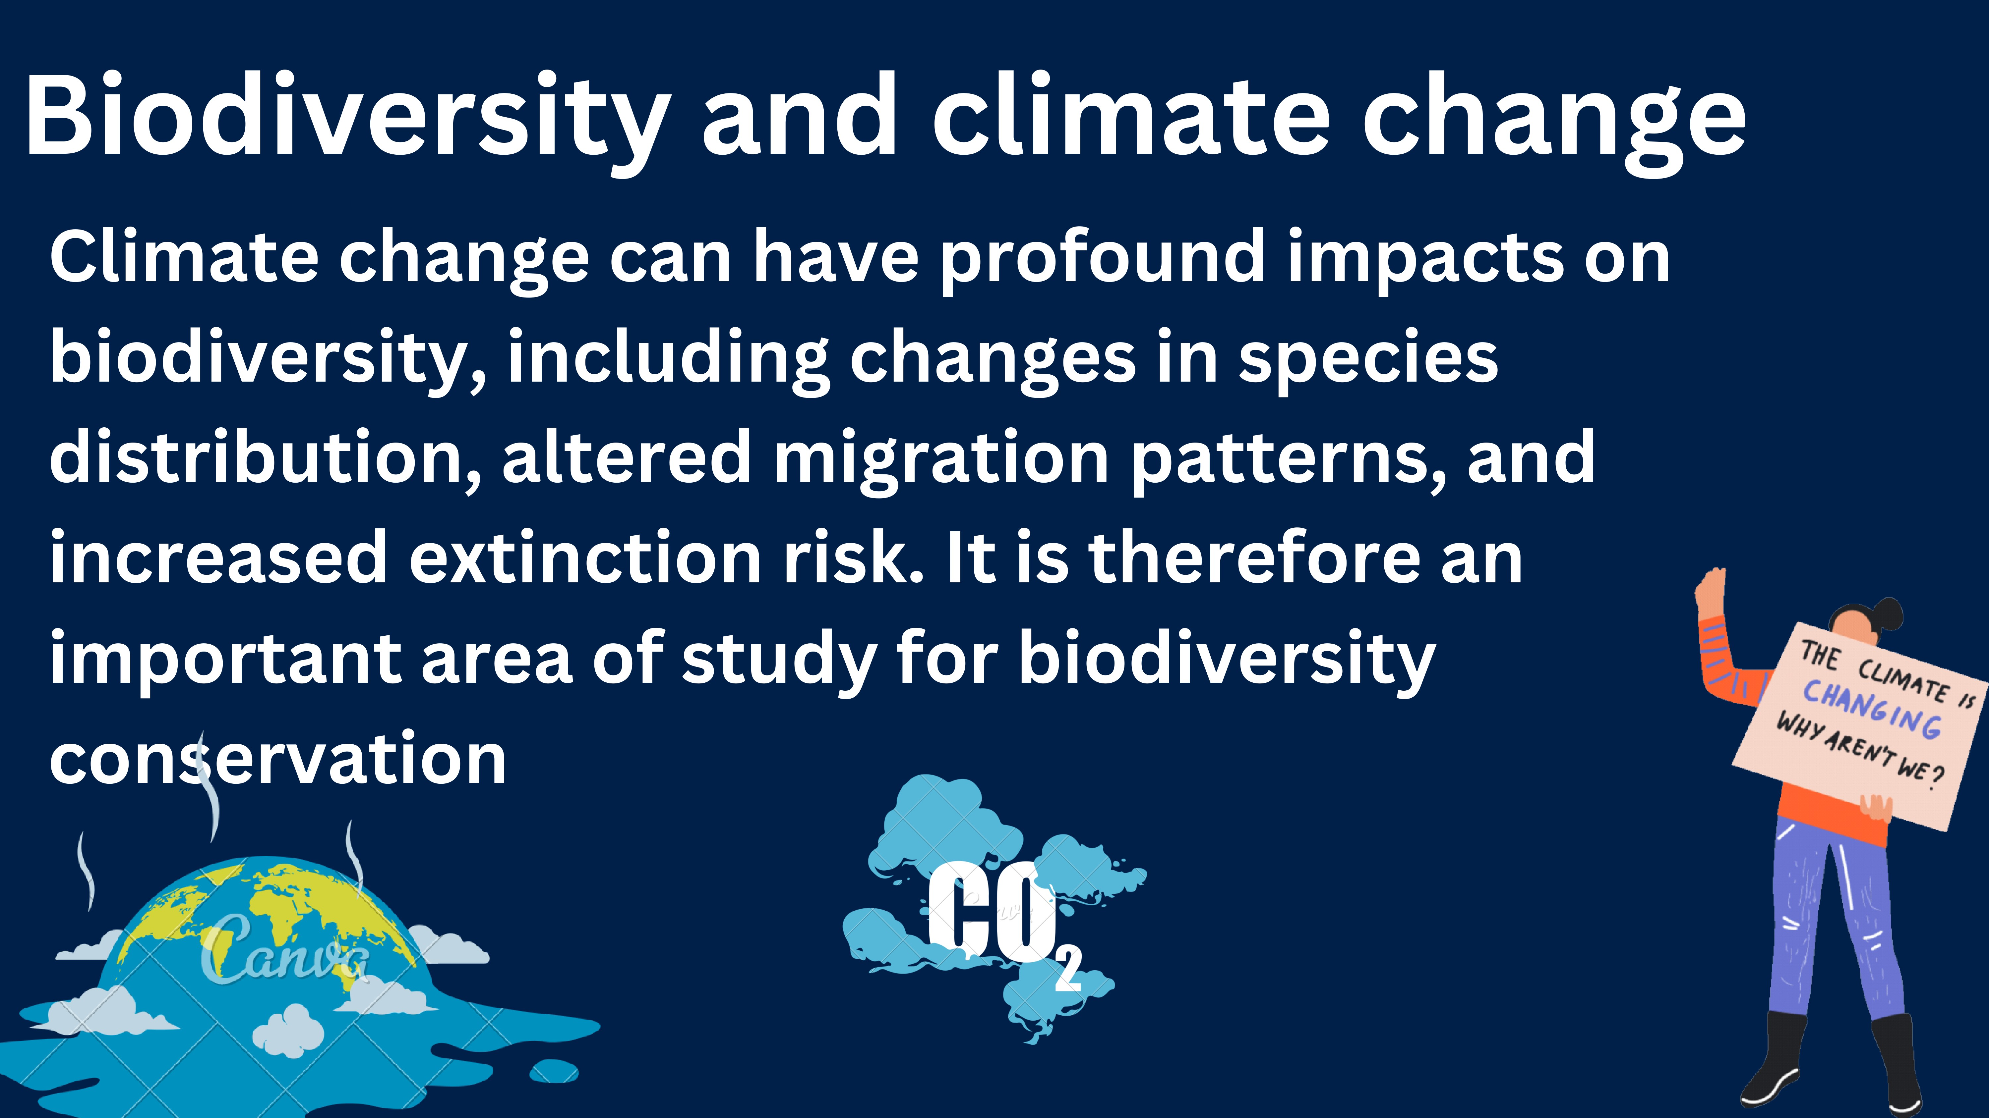

Slide 10
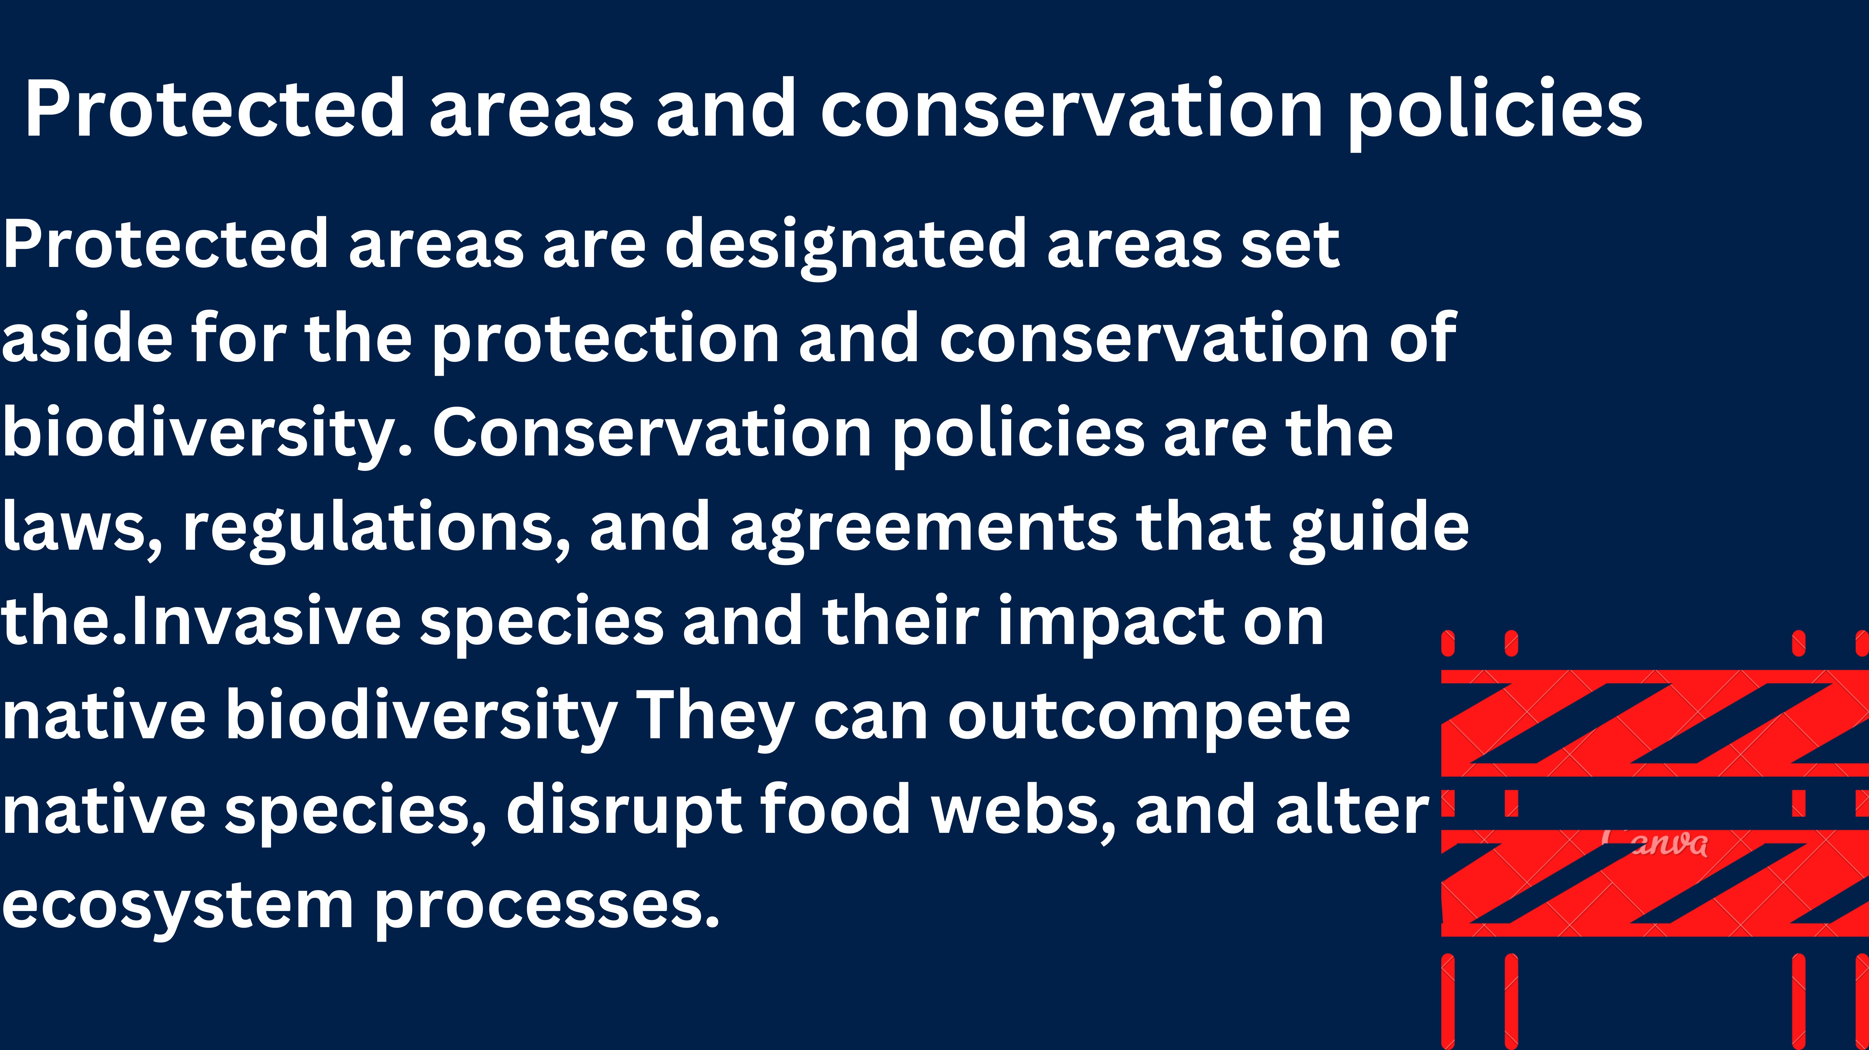

Slide 11
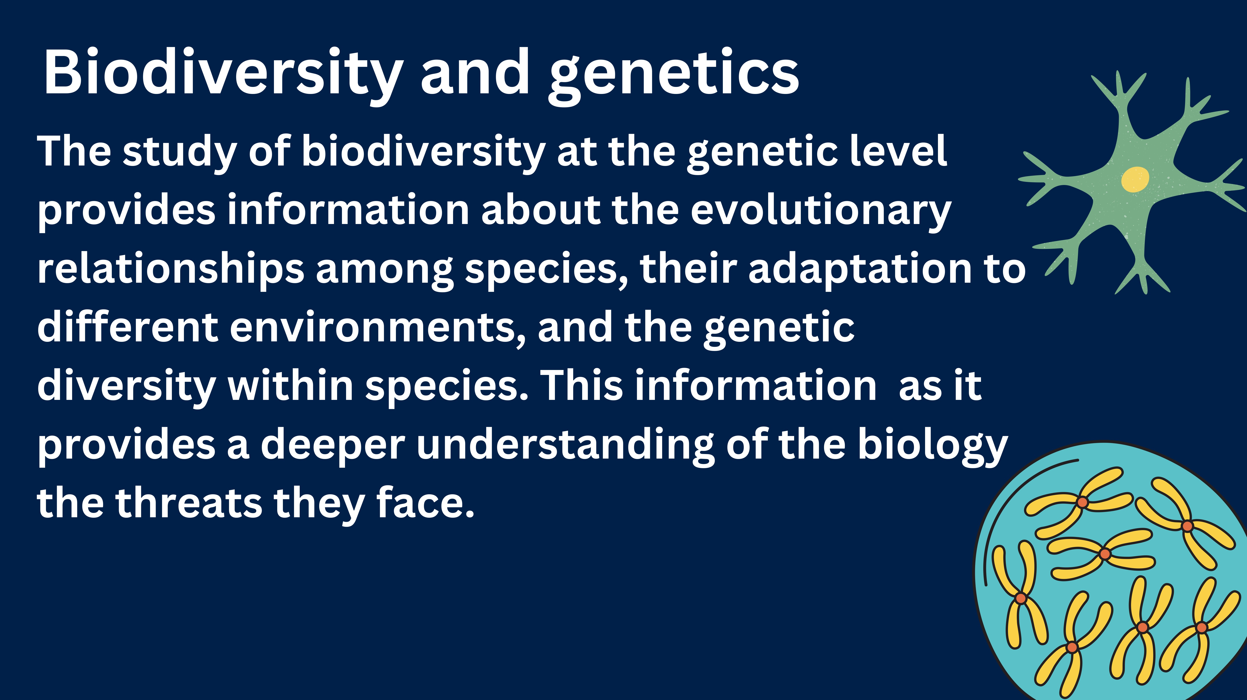

Slide 12
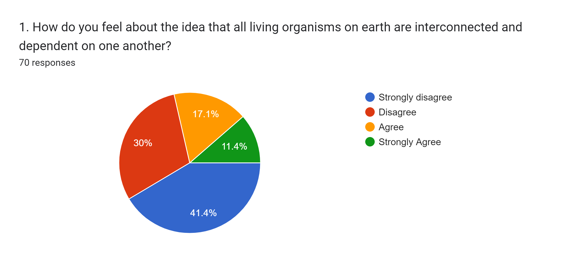
RESULT AND CONCLUSION
What we have got to this survey question here most of the members have strongly disagreeing that all living organisms on earth are interconnected and dependent on one another.

Slide 13
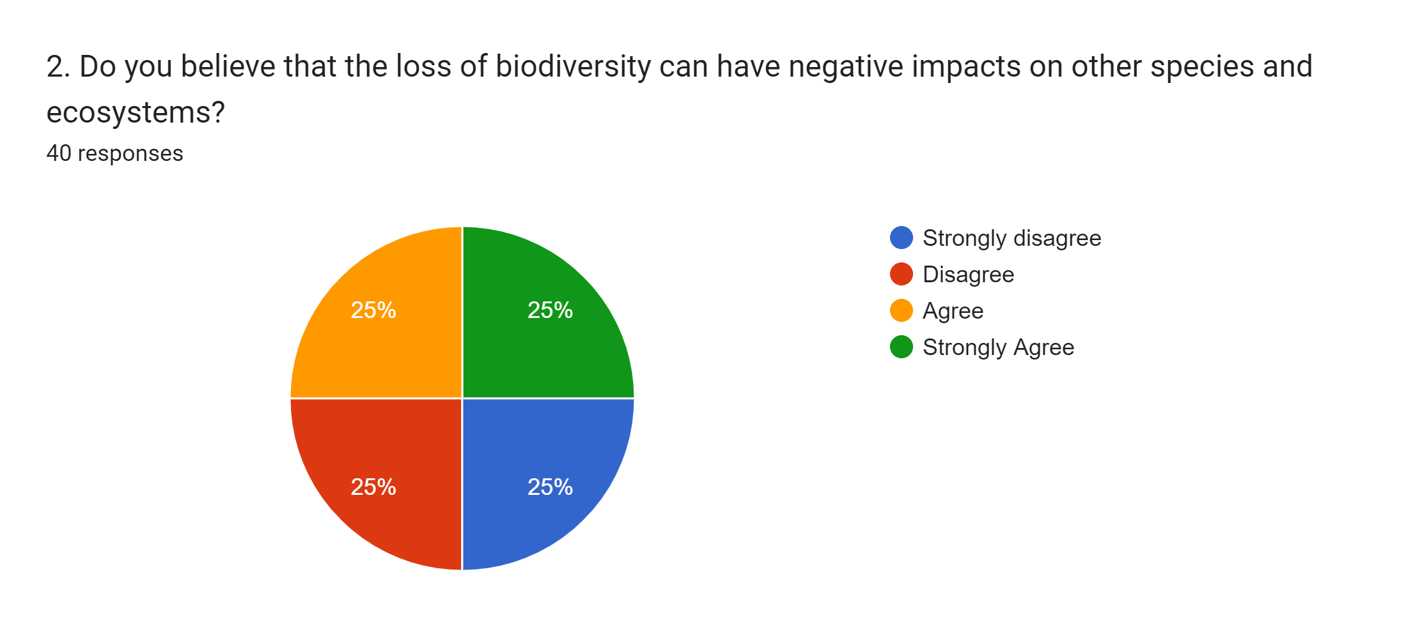
What we have got to this survey question here most of the members have agreeing that the loss of biodiversity can have negative impacts on other species and ecosystems.

Slide 14
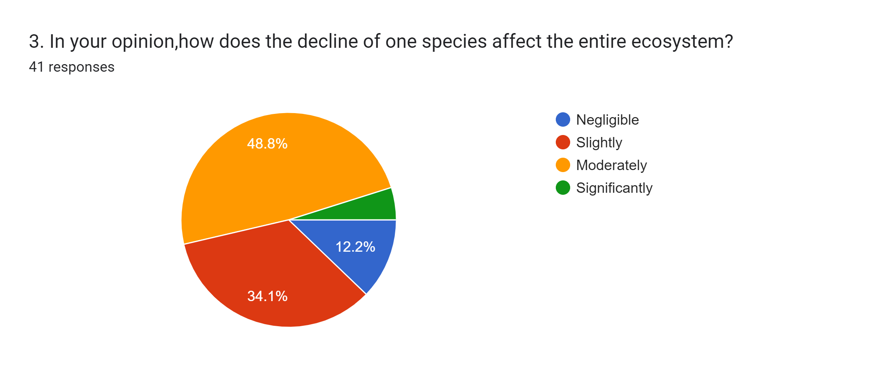
What we have got to this survey question here most of the members have given the answer moderately for the decline of one species affect the entire ecosystem.

Slide 15
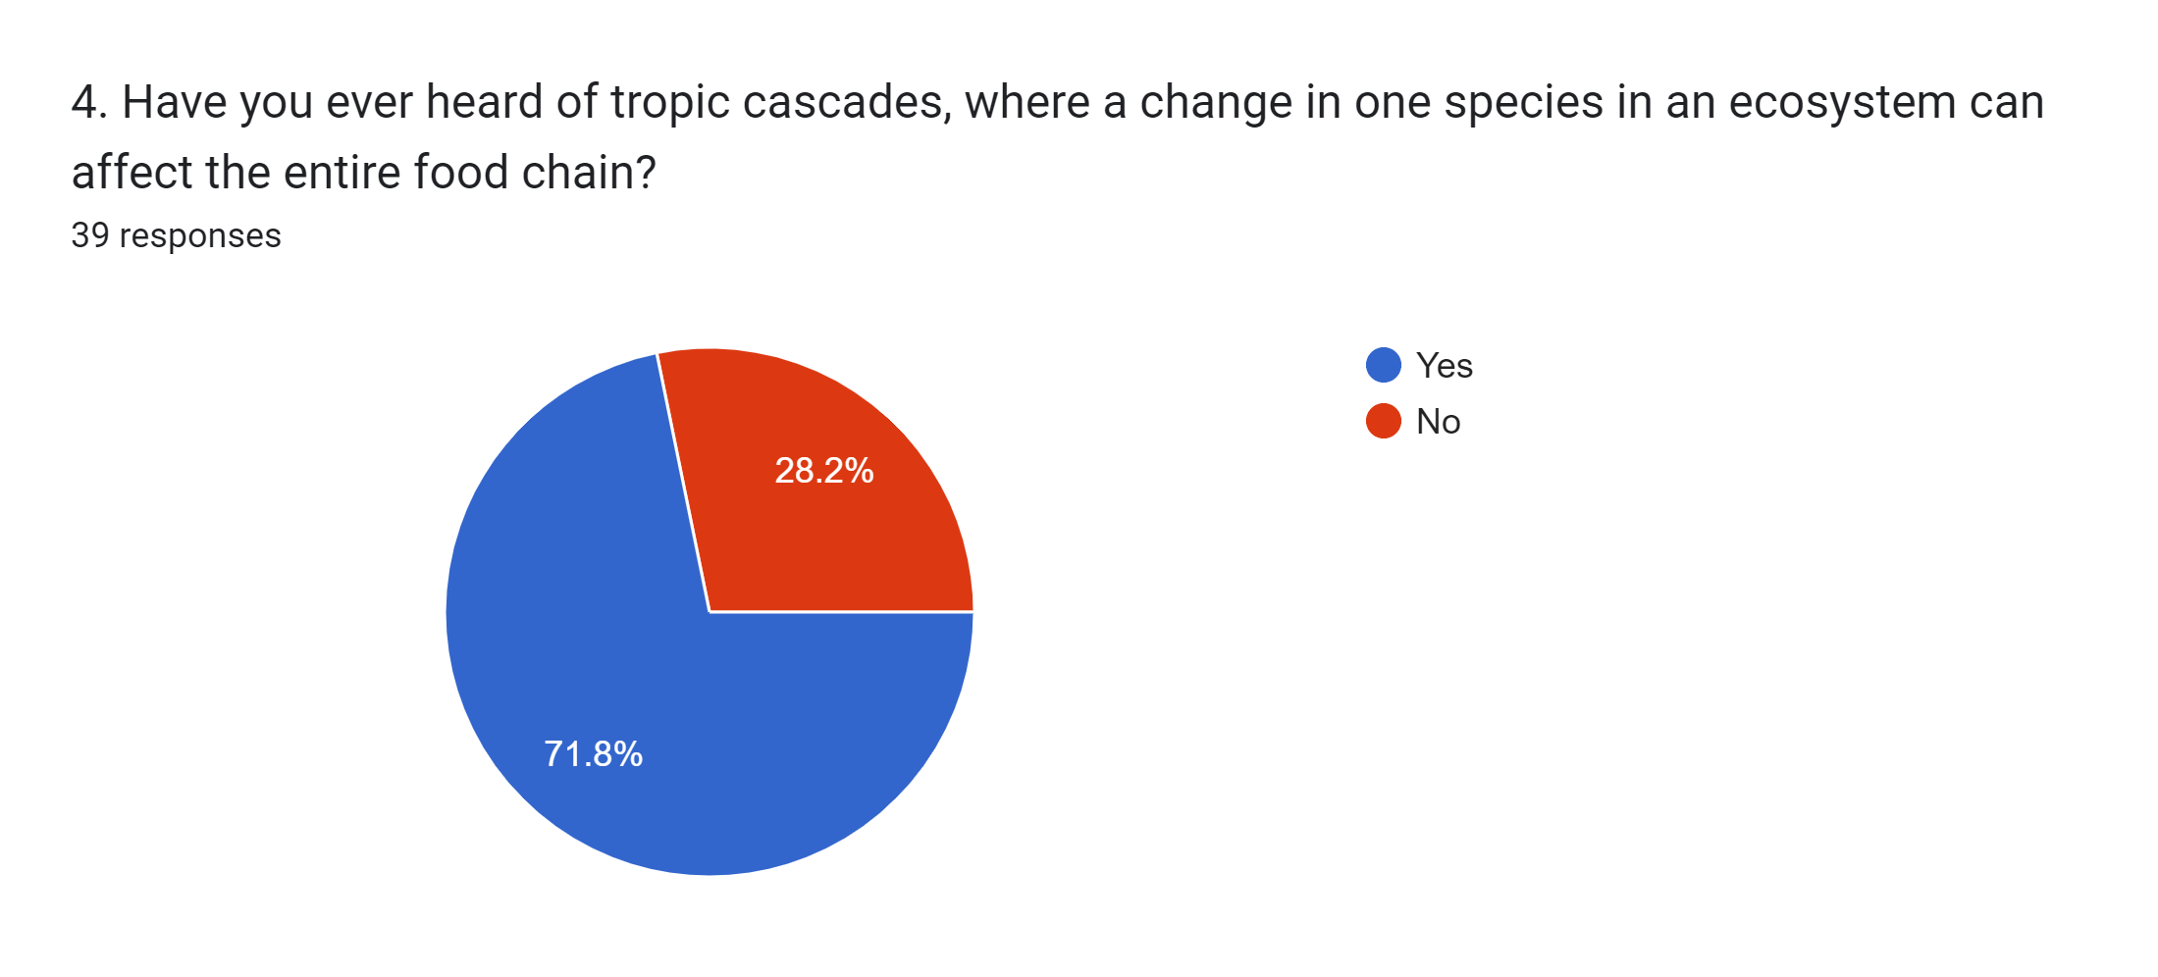
What we have got to this survey question here most of the members have said yes for question we asked here and also most of the members have aware of Tropic Cascades.

Slide 16
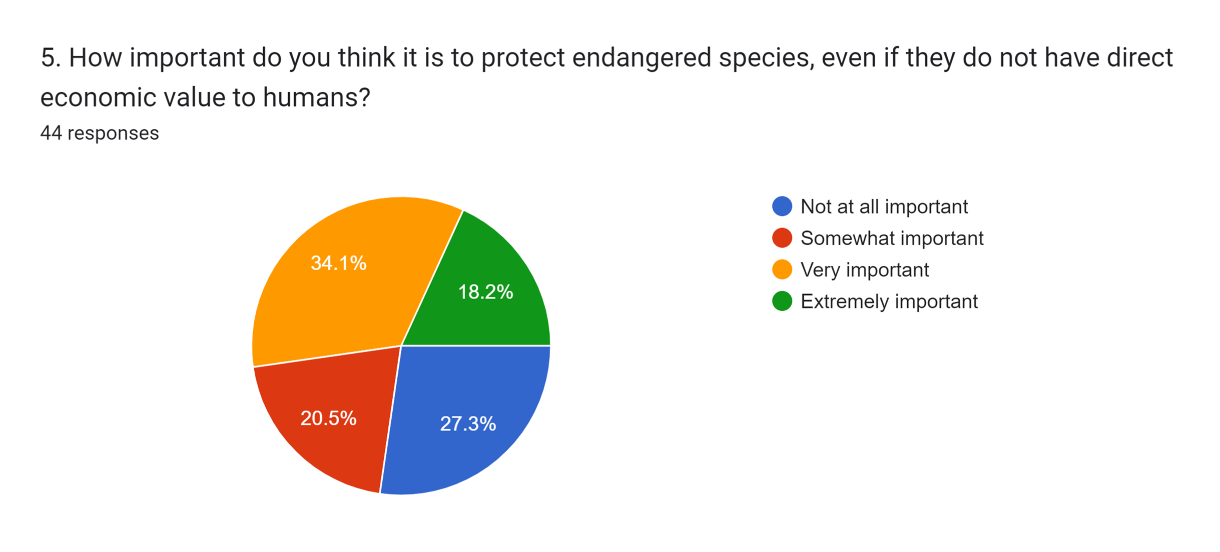
What we have got to this survey question here most of the members have said very important for question we asked here.

Slide 17
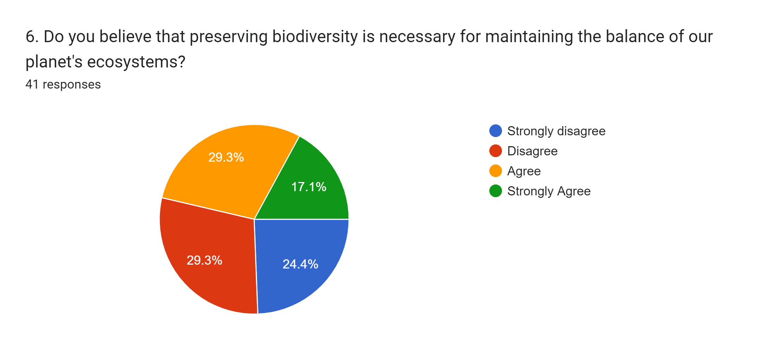
What we have got to this survey question here most of the members have Disagreeing for question we asked here.

Slide 18
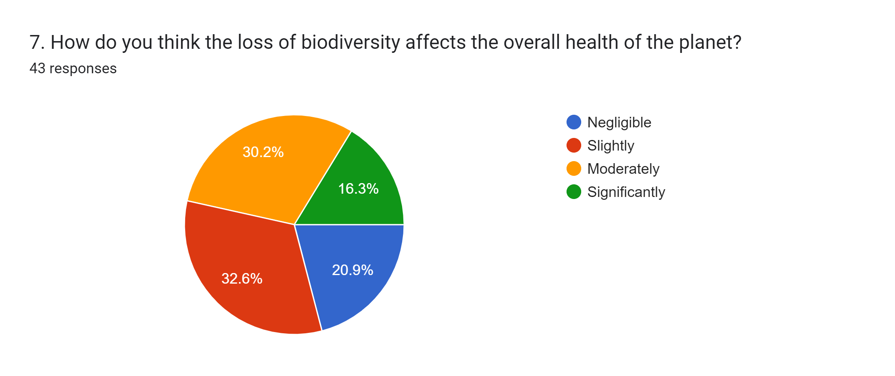
What we have got to this survey question here most of the members have slightly agreeing that the loss of biodiversity affects the overall health of the planet.

Slide 19
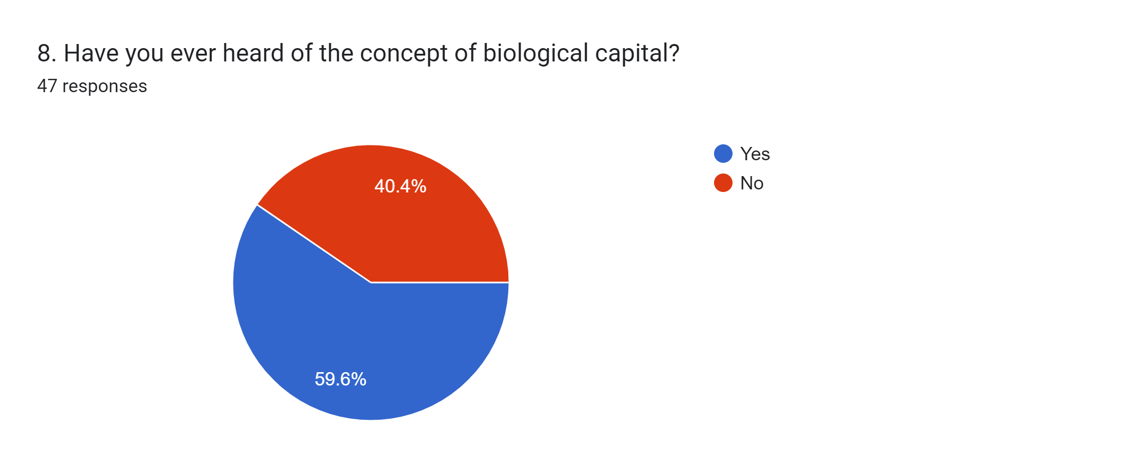
What we have got to this survey question here most of the members have said Yes that they have heard of the concept of biological capital.

Slide 20
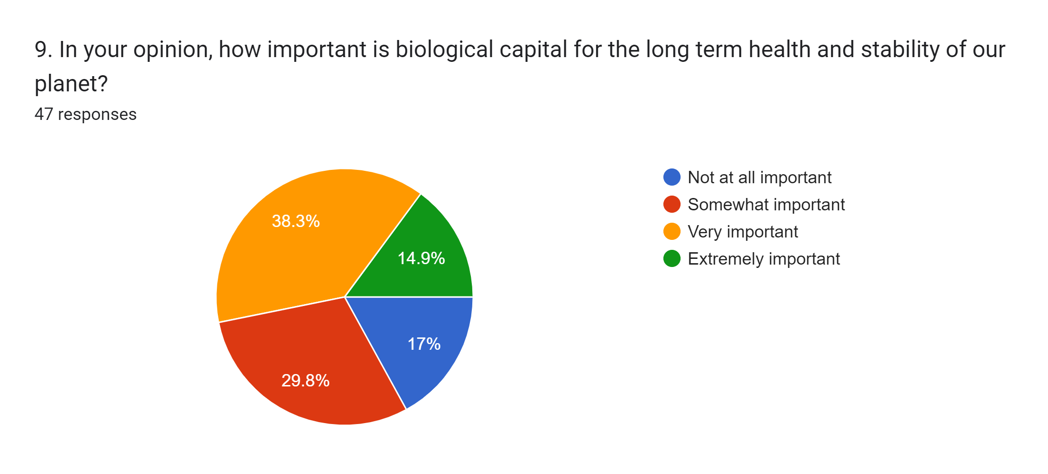
What we have got to this survey question here most of the members have said biological capital is very important for the long term health and stability of our planet.

Slide 21
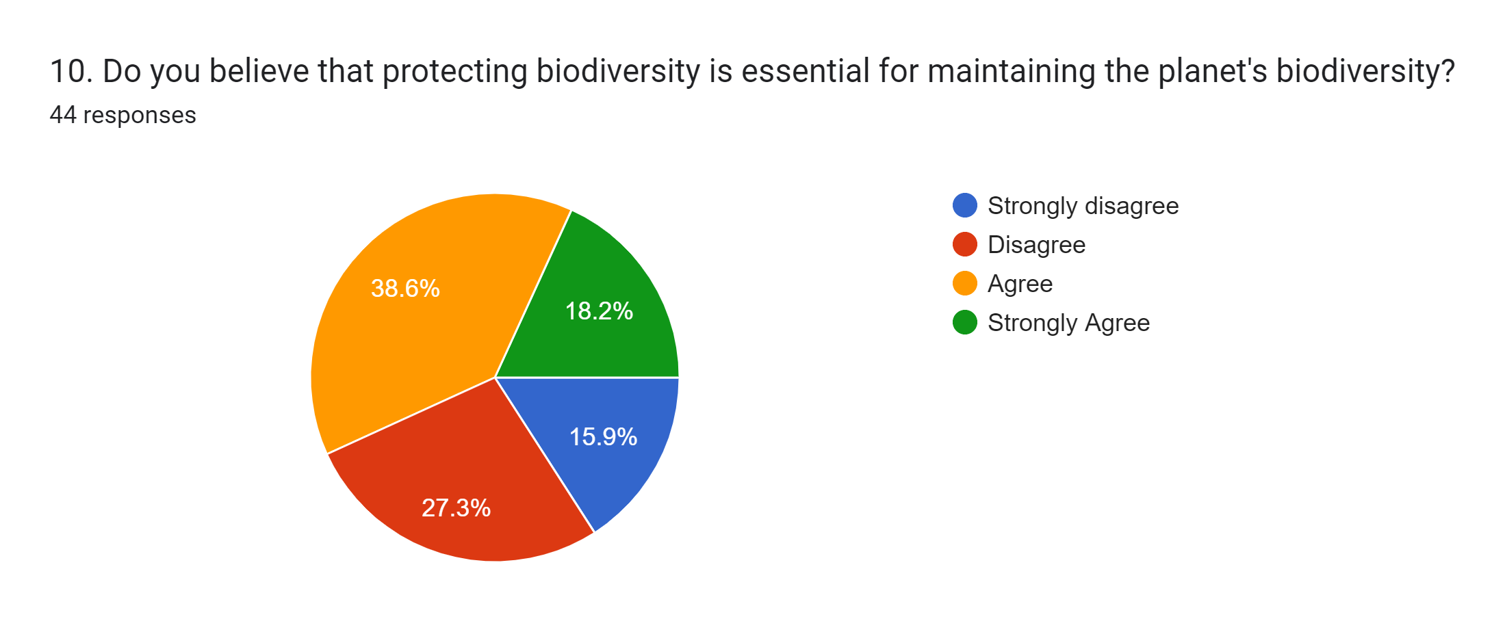
What we have got to this survey question here most of the members have agreeing for question we asked here.

Slide 22
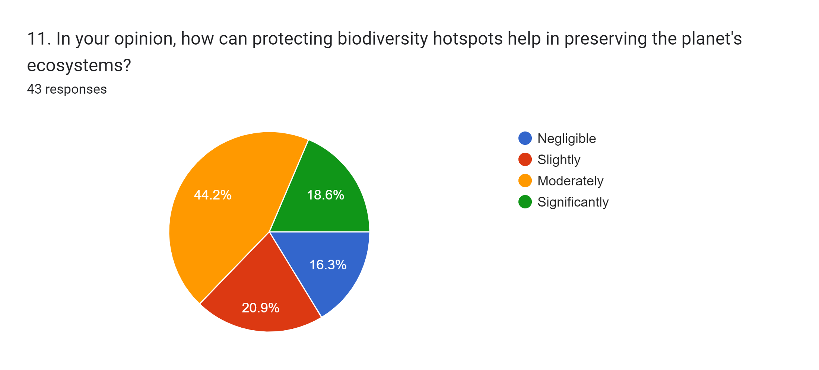
What we have got to this survey question here most of the members have moderately accepting for question we asked here.

Slide 23
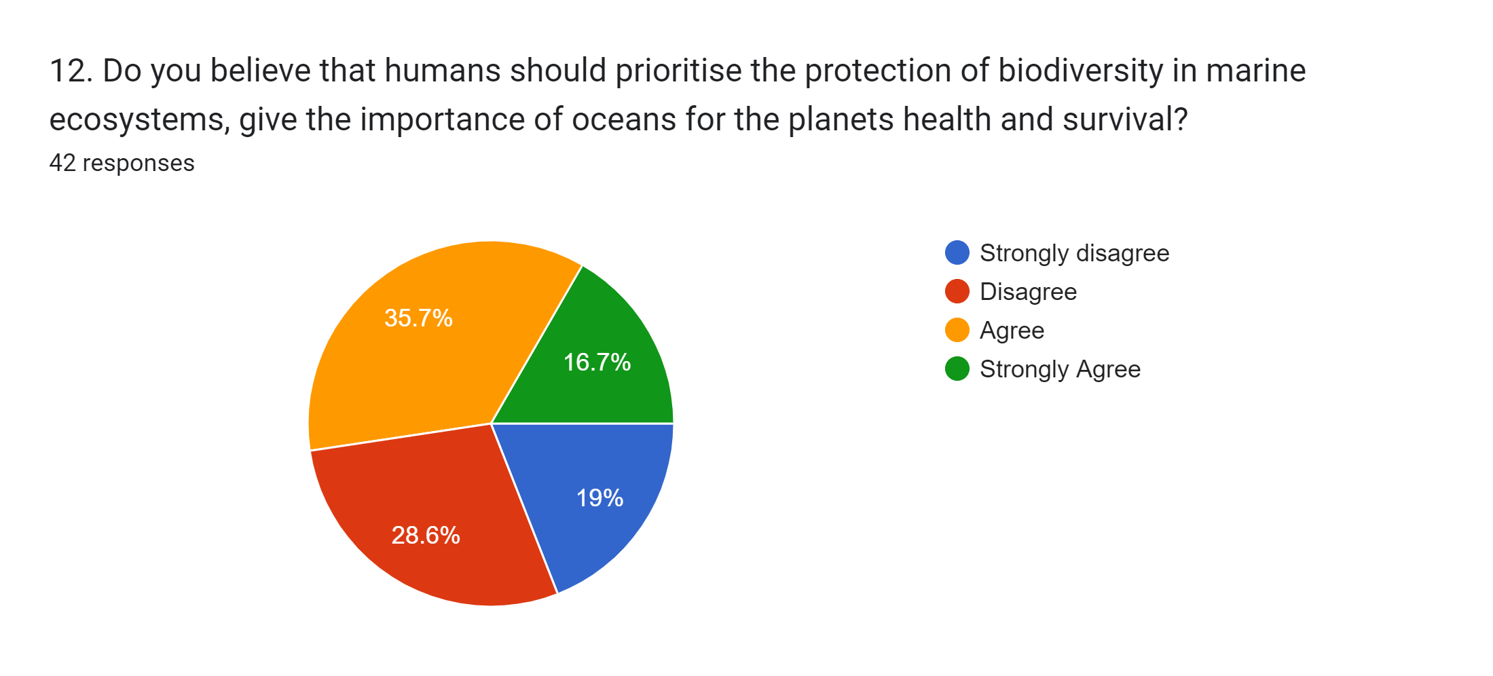
What we have got to this survey question here most of the members have agreeing for question we asked here.

Slide 24
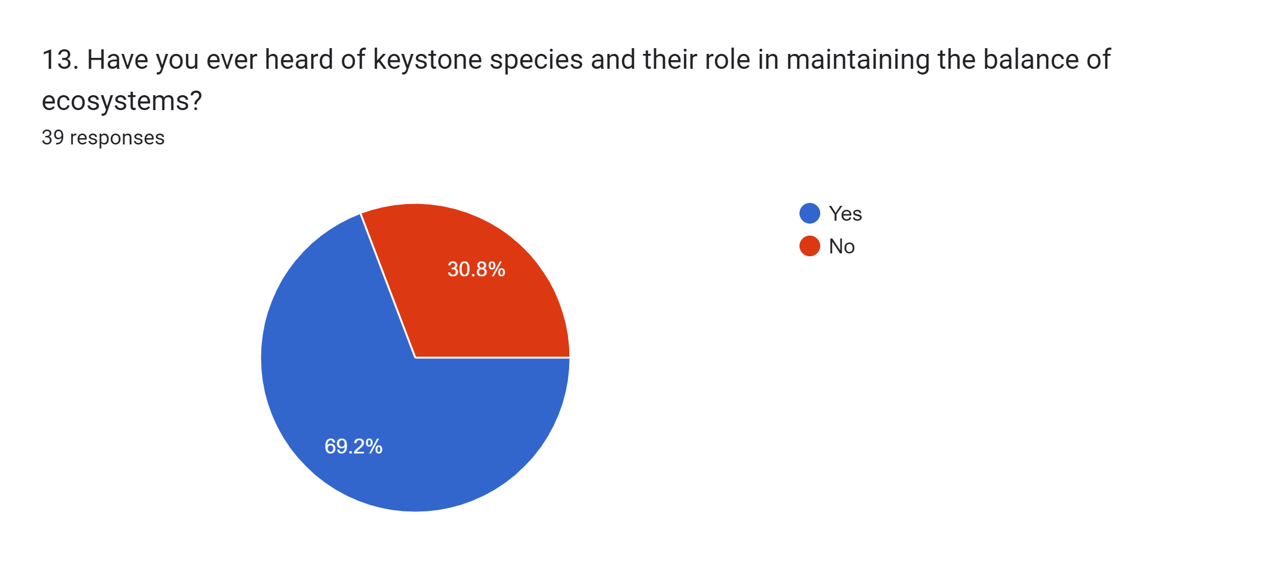
What we have got to this survey question here most of the members have said Yes that they have ever heard of keystone species and their role in maintaining the balance of ecosystems.

Slide 25
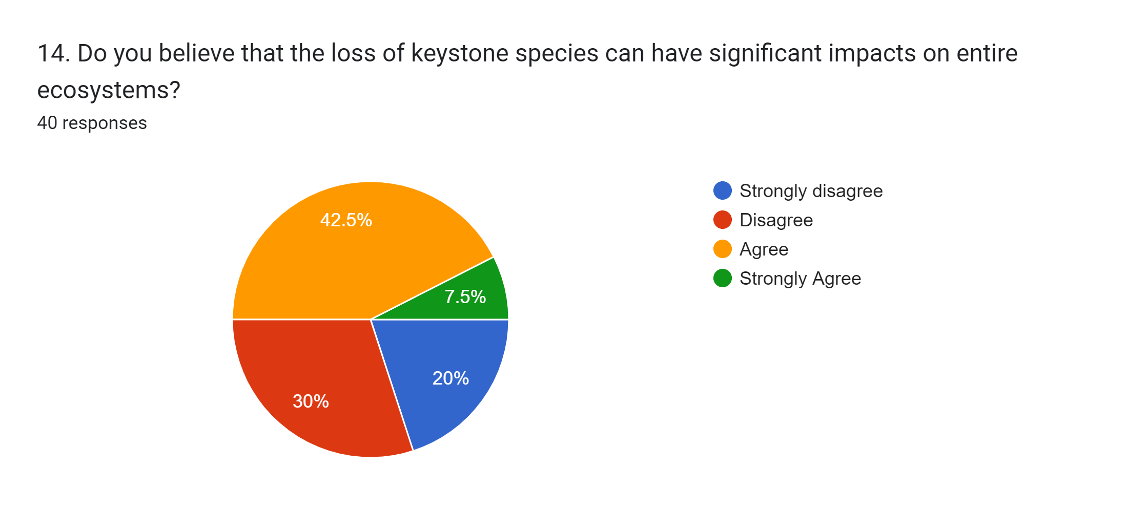
what we have got to this survey question here most of the members have agreeing for question we asked here.
What we have got to this survey question here most of the members have agreeing for question we asked here.

Slide 26
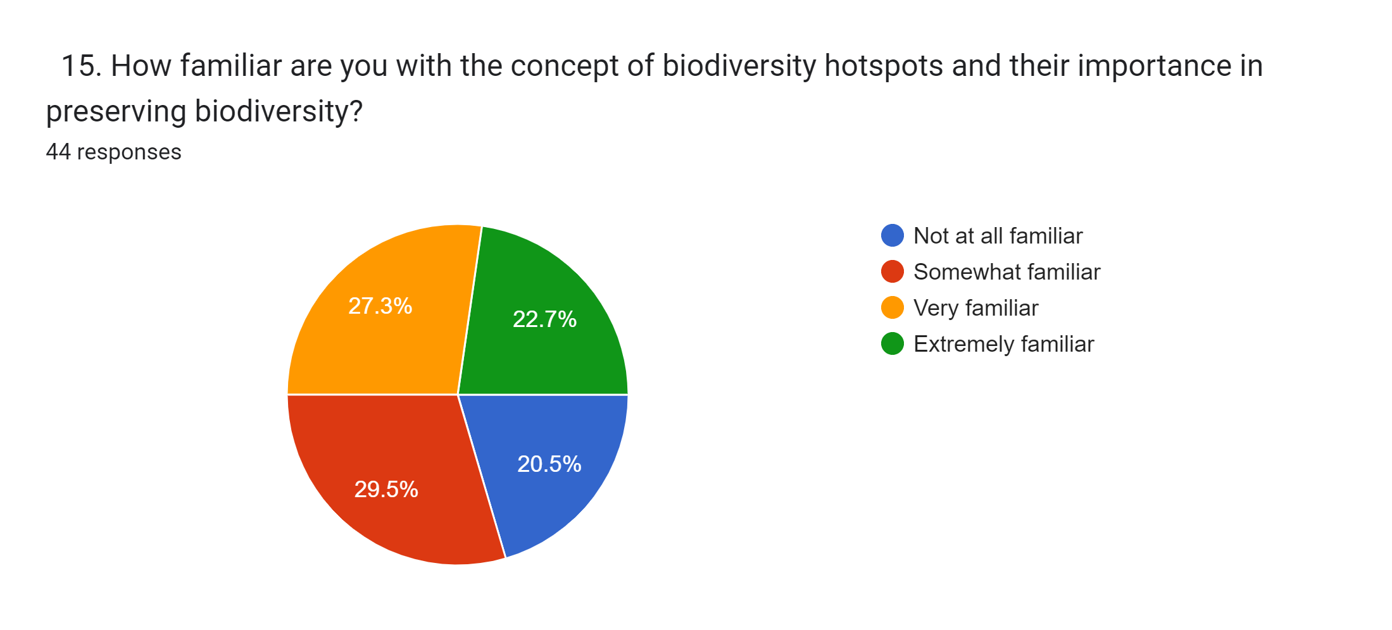
What we have got to this survey question here most of the members have saying it is somewhat Familiar for this question.

Slide 27
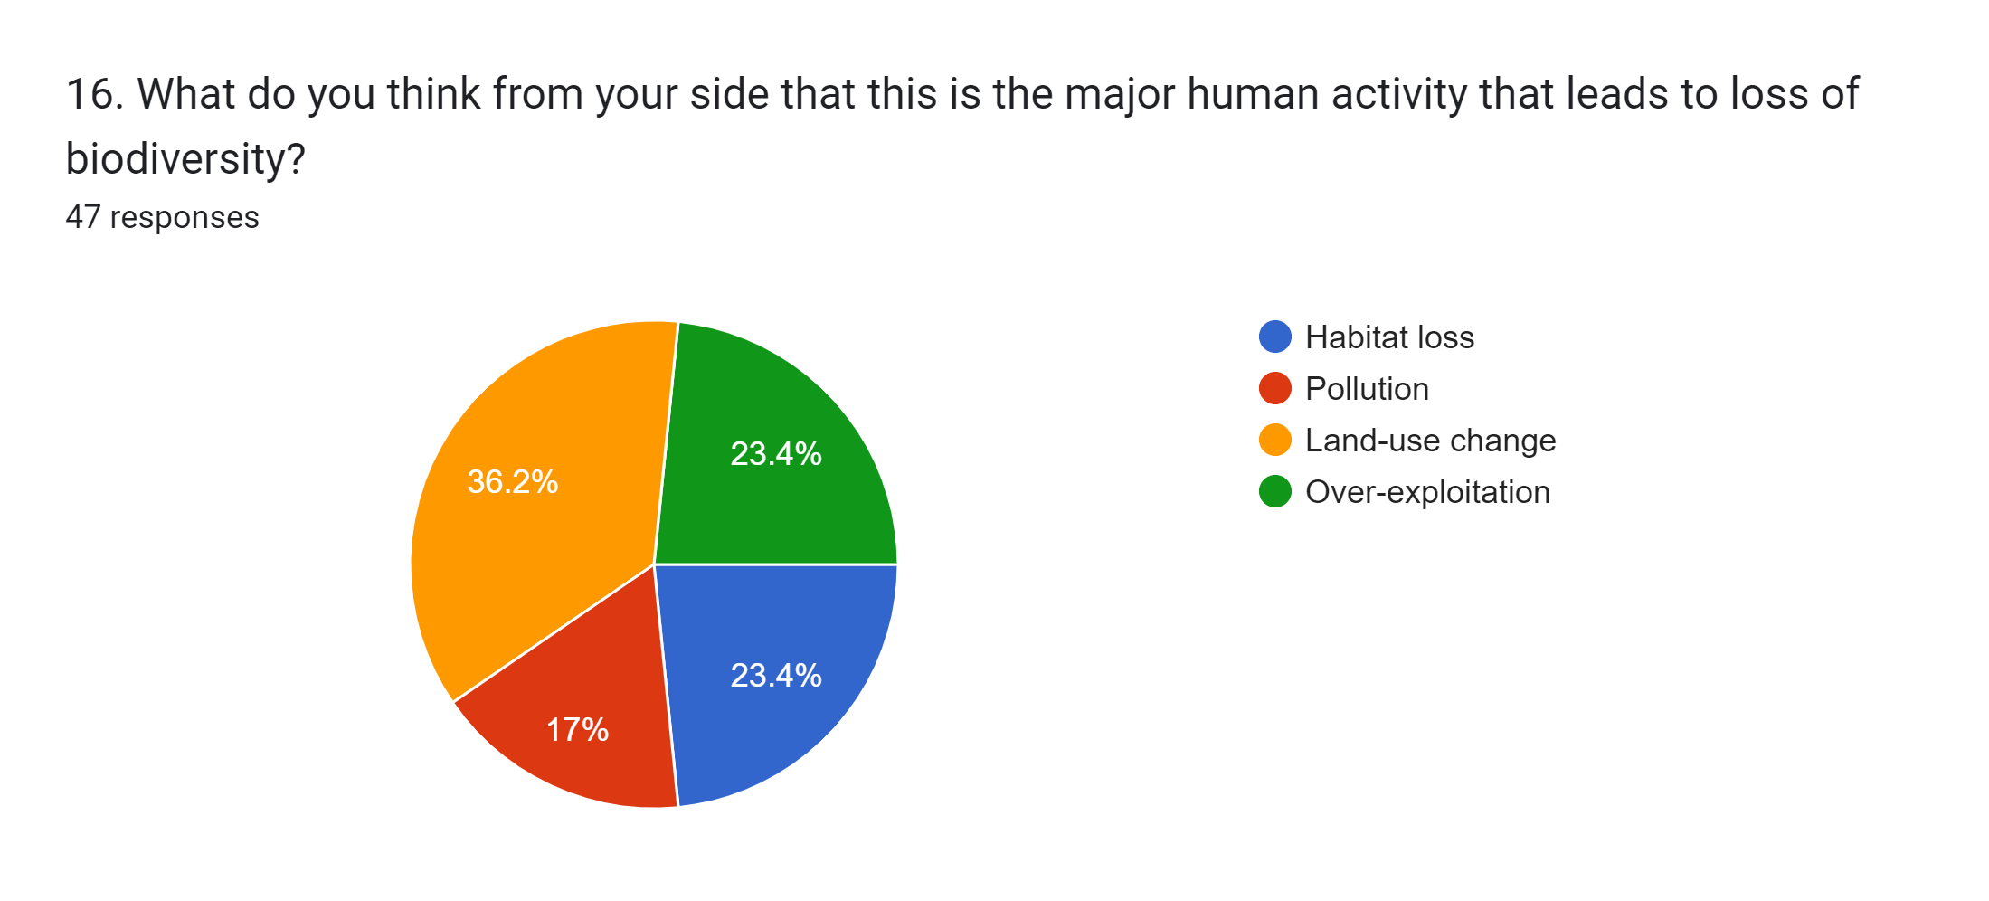
What we have got to this survey question here most of the members have said that Land use change is the major human activity that leads to loss of biodiversity.

Slide 28
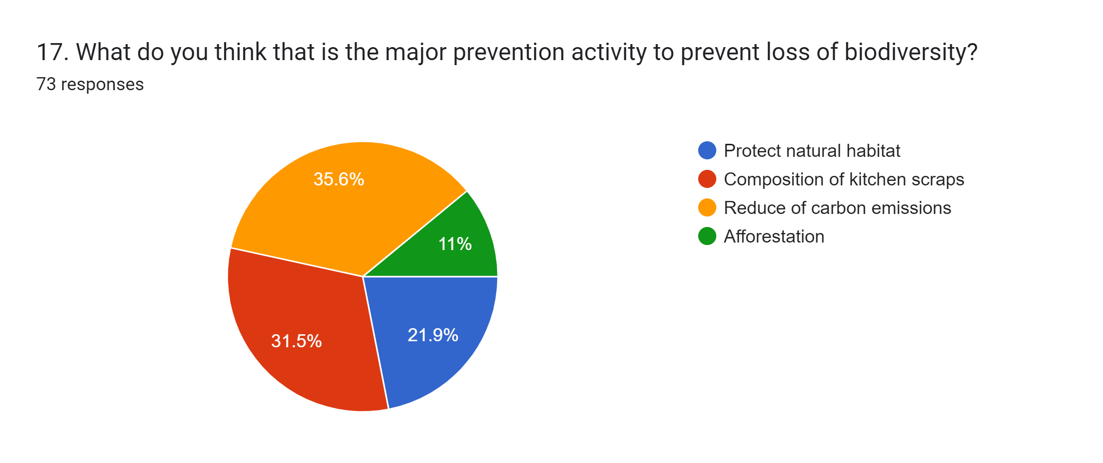
What we have got to this survey question here most of the members have said that Reduce of carbon emissions is the major prevention activity that leads to prevent loss of biodiversity.

Slide 29
CONCLUSION
In conclusion, biodiversity refers to the variety of life on Earth, including the diversity of species, ecosystems, and genetic diversity within species.
This rich tapestry of life forms a complex web of relationships and connections, with each species playing a unique role in maintaining the balance and stability of ecosystems.
Biodiversity provides numerous essential services to humanity, including food, medicine, clean air and water, and ecosystem services that support the livelihoods of billions of people.
However, human activities, such as habitat destruction, over-exploitation, and the introduction of invasive species, are causing declines in biodiversity at an unprecedented rate.
It is imperative that we take action to protect and conserve biodiversity, not just for its intrinsic value, but also for the benefits it provides to humanity. This requires a collaborative effort, involving government agencies, NGOs, local communities, and individual citizens, to raise awareness, implement conservation measures, and promote sustainable use of biodiversity.
In this sense, biodiversity is not just about the special connection between all organisms on our planet, but also about our connection to the natural world and our responsibility to protect it for future. generations.

Slide 30
REFERENCE:-
"Biodiversity" by E.O. Wilson (1988)
"The Diversity of Life" by Edward O. Wilson (1992)
"Conserving Biodiversity: Species, Ecosystems, and Genetics" edited by Michael L. Rosenzweig (1995)
"Biodiversity and Conservation" edited by Michael L. Rosenzweig (2010)
"Biodiversity and Ecosystem Functioning: Synthesis and Perspectives" edited by F. Stuart Chapin III, Pamela A. Matson, and Harold A. Mooney (2002)
"Biodiversity Conservation: Problems and Policies" edited by C.K. Minhas, P.K. Khosla and P.C. Pande (2002)
"Biodiversity: An Introduction" by Kevin J. Gaston and John I. Spicer (2004)
"Biodiversity and Climate Change: An Open Letter to Policymakers" edited by Lee Hannah, Camille Parmesan and Gary Yohe (2005)
"Biodiversity in Drylands: Toward a Unified Framework" edited by Osvaldo E. Sala, Brian Walker and Anantha Duraiappah (2011)
"Global Biodiversity Outlook" published by the Convention on Biological Diversity (CBD) (various editions).

Slide 31
THANK YOU

